Slide 1
MP3 STEGANOGRAPHY
Ben Khodja
Yalinne Castelan

Slide 2
Issues and Problems Addressed
The MP3-encoded audio file is known and used by nearly everyone who uses an electronic device
Most users aren’t aware that forms of MP3 file steganography exist, including:
  Hiding information during the MP3 encoding process
  Hiding information after the MP3 encoding process
Notes:
Example tool that hides information within MP3 files during the encoding process:
- Fabien Petitcolas’ MP3Stego
- Hides information within the main data portions of an MP3 file.
- Essentially a modified version of an MP3 encoder which uses a .wav audio file and the information to be hidden as inputs.
- The hiding is performed during the “inner_loop” stage of the encoding process which is where quantization of the input audio takes place.
Example tool that hides information within MP3 files after the encoding process:
- Mike Zaturenskiy’s MP3Stegazaurus
- Hides information within portions of MP3 files known to be skipped, ignored, and/or unused by MP3 playing and decoding applications.
(Several Frame Header portion bits, Side Information portion Padding bits, Main Data portion bits of “empty” frames, and Ancillary Data portion bits)
- Recently, MP3StegDetector was developed in order to detect and extract information hidden that was within MP3 files using MP3Stegazaurus.
- The tool that we are working on developing will also hide information after the encoding process has taken place, but it will instead hide the information within the main data portions of an MP3 file.

Slide 3
Issues and Problems Addressed
Currently, no tool exists for hiding information within the main data portions of an MP3 file after the encoding process has taken place
There exists no steganalysis tool capable of detecting/extracting information hidden within the main data portions of an MP3 file
Notes:
By main data portions, we mean the main data portions of frames considered not to be empty.
- Mikhail Zaturenskiy’s MP3Stegazaurus tool does hide information within the main data portions on an MP3 file, but only if they are completely empty.
- As mentioned previously, there only exist tools capable of hiding information within the main data portions of an MP3 file during the encoding process.

Slide 4
Project Tasks
Research the MP3 file
  Encoding and decoding processes
  Huffman Coding
  Modified Discrete Cosine Transform (MDCT)
  Structure and contents of the main data portion
Develop an MP3 file steganography/steganalysis tool
  Injects information within the main data portions of an MP3 file without introducing audible artifacts
  Detects/extracts information hidden within the main data portions of an MP3 file

Slide 5
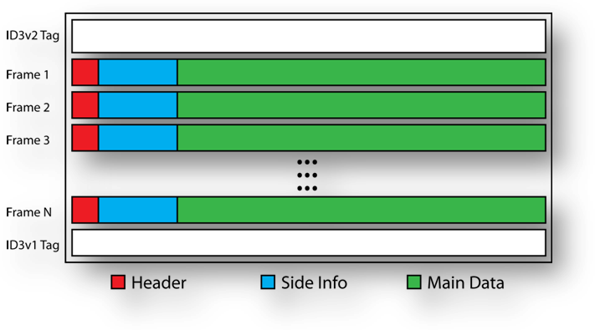
MP3 File Structure
Image Source – MP3 Files as a Steganography Medium by Mikhail Zaturenskiy
Notes:
- After the MP3 encoding process has taken place, a file is produced which is composed of a number of frames and an optional ID3v1 Tag or ID3v2 Tag.
- Every frame contains a Header portion, a Side Information portion, and a Main Data portion.
- Header portion: Contains information related to the frame itself including values such as bitrate and sampling frequency.
- Side Information portion: Contains all of the information needed in order to locate, decompress, and decode the audio information contained within
the main data portion belonging to a particular frame.
- Main Data portion: Contains the audio information belonging to a particular frame (explained in more detail in the following slides).

Slide 6
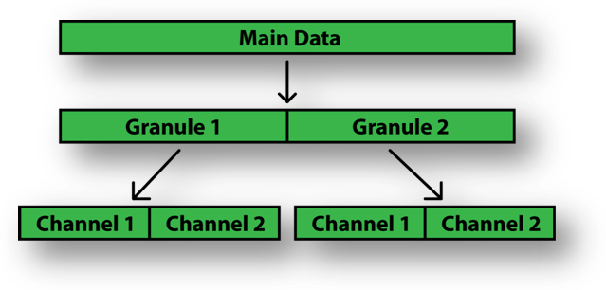
Main Data Portion
Image Source – MP3 Files as a Steganography Medium by Mikhail Zaturenskiy
Notes:
The main data portion of each frame is made up of 2 granule portions, and each granule portion is made up of either 1 or 2 channel portions depending on whether the MP3 file was encoded in single- or dual-channel mode. For performance reasons, the audio information contained within each channel (scalefactor values and MDCT-encoded frequency subband values) is split into 3 regions named “region0,” “region1,” and “region2,” and each of these regions is compressed individually using different Huffman Coding tables (if necessary).
The main data portion of each frame contains exactly 26 milliseconds worth of audio information.

Slide 7
Hiding Information in Main Data Portion
Will require at least the following:
  1. Decode Huffman-encoded bits by referring to table_select fields for each channel portion present within a frame’s side information portion
  2. Modify scalefactor values and/or MDCT-encoded frequency subband values in order to store information that is to be hidden
  3. Update table_select fields for any channels that were modified
  4. Compress scalefactor values and MDCT-encoded frequency subband values using updated table_select fields

Slide 8
Demo

Slide 9
Findings
Modifying the uncompressed regions in a way that renders the Huffman Coding invalid/corrupt appears to cause MP3 players to either repeat the previous frame or skip the frame altogether
Modifying several contiguous frames appears to cause MP3 players to stop playing an MP3 file
Modifying the size of the main data portion
decrease/increase
Notes:
Windows Media Player, GoldWave, WinAmp
25 files from itunes, amazon, AND we create our own using GoldWave
When modifying 5 or more frames the song stop playing

Slide 10
Next Semester
Study code provided by jLayer Java libraries to figure out how to perform Huffman Decoding and determine exactly how MDCT-encoded data is organized
Automate the information hiding/recovering processes within modified version of MP3StegDetector

Slide 11
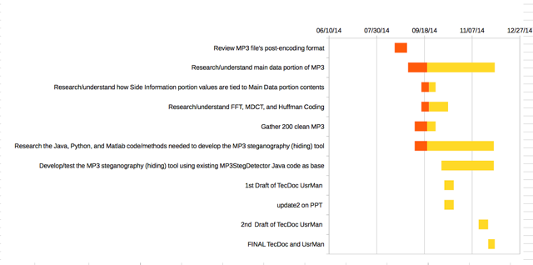
Gantt Chart

Slide 12
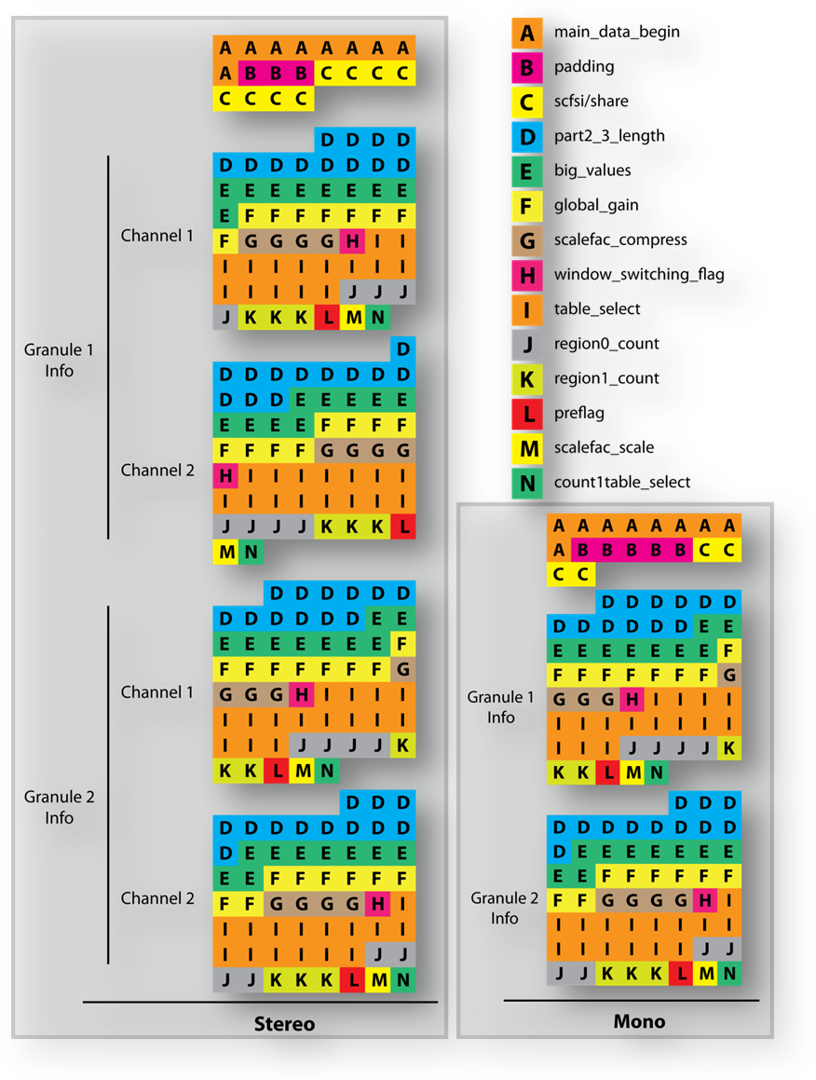
Side Information Portion
Image Source – MP3 Files as a Steganography Medium by Mikhail Zaturenskiy
Notes:
As mentioned previously, the Side Information portion contains all of the information needed in order to locate, decompress, and decode the audio information contained within the main data portion belonging to a particular frame. For a dual-channel MP3 file, the Side Information portion is 32 bytes in length and holds information for both channels in both granules. For a single-channel MP3 file, the Side Information portion is 17 bytes in length and holds information for both granules.
- The “part2_3_length” field holds the total length in bits for a particular channel (or granule in the case of a single-channel MP3 file). It can be used to determine the beginning and ending locations of a particular granule or channel.
- The “table_select” and “count1table_select” fields are used to specify which Huffman Coding tables are to be used in order to decompress the Huffman-encoded data stored within the three regions of a particular channel (or granule in the case of a single-channel MP3 file). These Huffman Coding tables have been pre-defined and are part of the MP3 standard. They appear in the “Table B.7 – Huffman codes for Layer III” section of the standard (ISO/IEC 11172-3 – Coding of moving pictures and associated audio for digital storage media at up to about 1.5 Mbit/s).
- The “region0_count” and “region1_count” fields hold the lengths in bits of “region0” and “region1.” These can be used to determine the beginning and ending locations of a channel’s particular regions.

Slide 13
References
Zaturenskiy, Mikhail. “MP3 Files as a Steganography Medium.” Illinois Institute of Technology, 2010.
Thiagarajan, Jayaraman Jayaraman., and Andreas Spanias. Analysis of the MPEG-1 Layer III (MP3) Algorithm Using MATLAB. San Rafael, CA: Morgan & Claypool, 2012. Print.
Hacker, Scot. MP3: The Definitive Guide. Sebastopol: O'Reilly Media, 2000. Print.
Raissi, Rassol. The Theory Behind MP3.
Maciak, Lukasz G., Michael A. Ponniah, and Renu Sharma. MP3 Steganography: Applying Steganography to Music Captioning.
Ruckert, Martin. Understanding MP3: Syntax, Semantics, Mathematics, and Algorithms. Wiesbaden: Vieweg, 2005. Print.
ISO/IEC 11172-3 – Coding of moving pictures and associated audio for digital storage media at up to about 1.5 Mbit/s, 1993.
Edström., Björn. "Blog.bjrn.se." Blog.bjrn.se. N.p., n.d. Web. 25 Nov. 2014.

